Slide 1


Heart
Disease
Diagnostic
Analysis

Slide 2
Introduction
Heart disease is a variety of issues that can affect your heart. When people think about heart disease, they often think of the most common type — coronary artery disease (CAD) and the heart attacks it can cause. But you can have trouble with different parts of your heart, like your heart muscle, valves or electrical system.
When your heart isn’t working well, it has trouble sending enough blood, oxygen and nutrients to your body. In a way, your heart delivers the fuel that keeps your body’s systems running. If there’s a problem with delivering that fuel, it affects everything your body’s systems do.
Lifestyle changes and medications can keep your heart healthy and lower your chances of getting heart disease.

Slide 3
Problem Statement
Health is real wealth in the pandemic time we all realized the brute effects of covid-19 on all
irrespective of any status. You are required to analyze this health and medical data for better
future preparation.
Do ETL: Extract- Transform and Load data from the heart disease diagnostic database
You can perform EDA through python. The database extracts various information such as
Heart disease rates, Heart disease by gender, by age.
You can even compare attributes of the data set to extract necessary information. Make the
necessary dashboard with the best you can extract from the data. Use various visualization
and features and make the best dashboard .

Slide 4
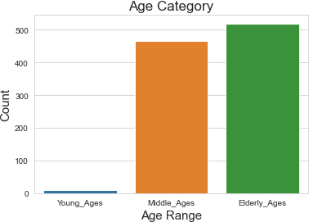
INSIGHTS
Percentage of people having heart disease= 51.31707317073171
There are more males in middle age and females in elderly age
category.

Slide 5
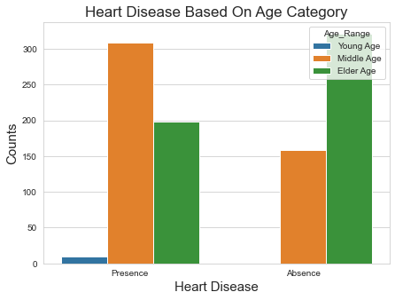
Heart Disease Based On Age Category
Middle ages are more
prone to heart diseases.

Slide 6
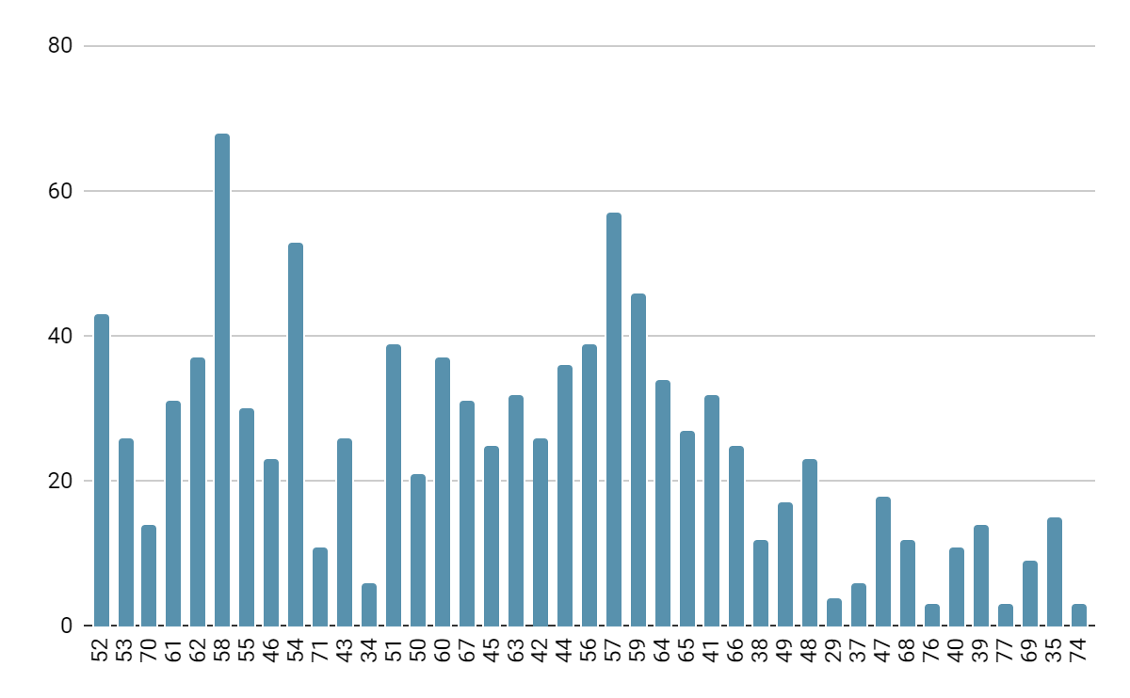
Age Count
From the bar plot we can tell that, people of ages 58 have highest count of suffering from heart diseases.

Slide 7
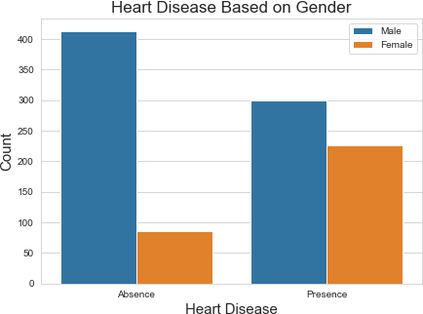
There are more males in whom heart diseases occur.

Slide 8
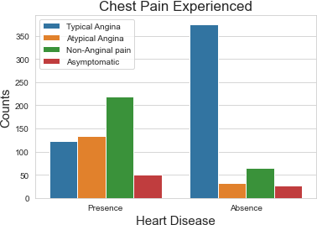
Chest Pain Experienced
Those with Typical Angina are seen to have no occurrence of any heart disease.

Slide 9
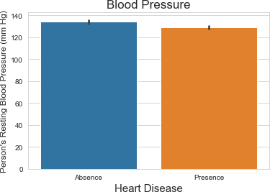
It seems a person's resting blood pressure has no relation to heart diseases in the given sample population.
Blood Pressure

Slide 10
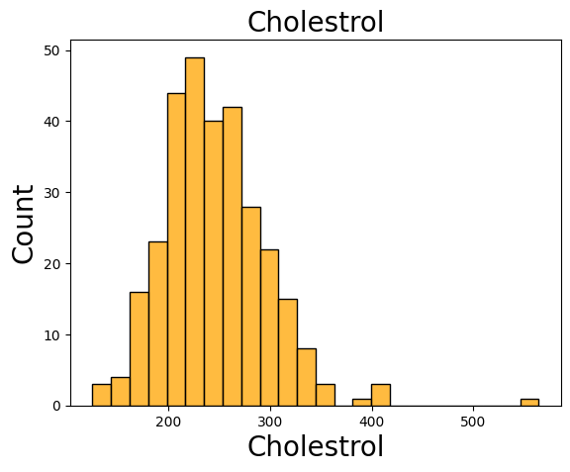
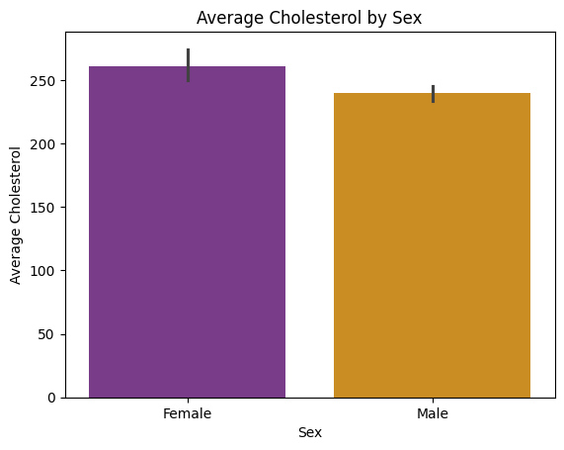
Cholesterol
It seems that female have higher average cholesterol compared to male.

Slide 11
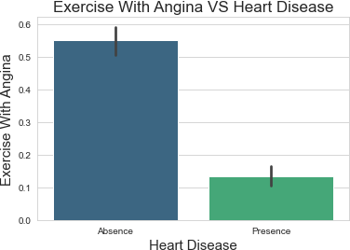
Exercise with Angina
Apparently people who suffering from Angina due to exercise are not likely to not get any heart diseases in the given dataset.

Slide 12

Bradly John

